Slide 1
SPACEHACK
2026
Marko & the Big Logs

Slide 2
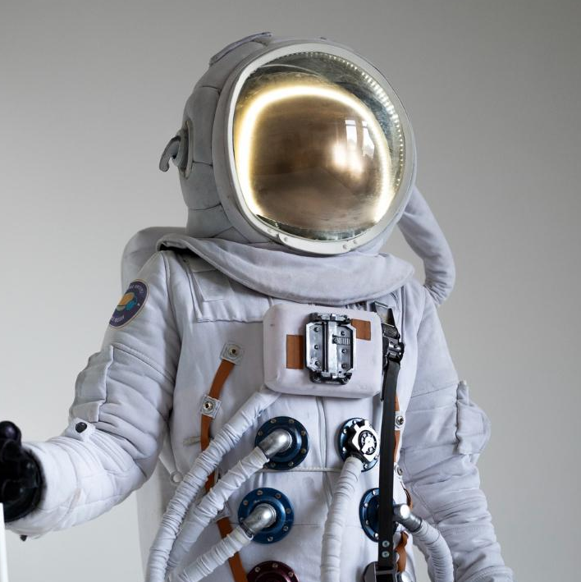
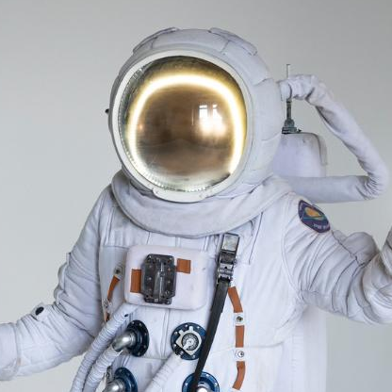




OUR TEAM
Marko
Lukas
Sagar
Sam
2nd Year Computer
Science Student
2nd Year Mechanical Engineering Student
2nd Year Electrical
Engineering Student
2nd Year Computer
Science Student

Slide 3
The problem…
Notes:
Task 1 finding our own problem and finding a solution

Slide 4
Oil companies such as Irving Oil need a way to monitor thousands of kilometers of pipeline easily and cost-effectively to look for vegetation, construction, and other obstructions.
Notes:
Threat detection and flagging for earth to do the elimination process

Slide 5
Our solution
Our solution aims to solve this problem by taking satellite images of these pipelines and using machine learning to only send photos when an obstruction is detected. It also optimizes bandwidth usage by splitting the photo and only sending the “slices” which are deemed most important.

Slide 6
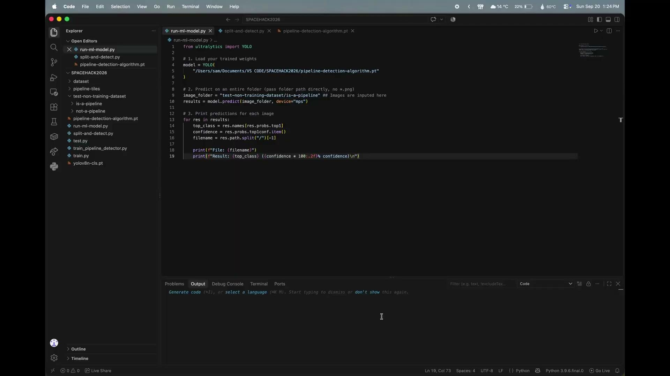
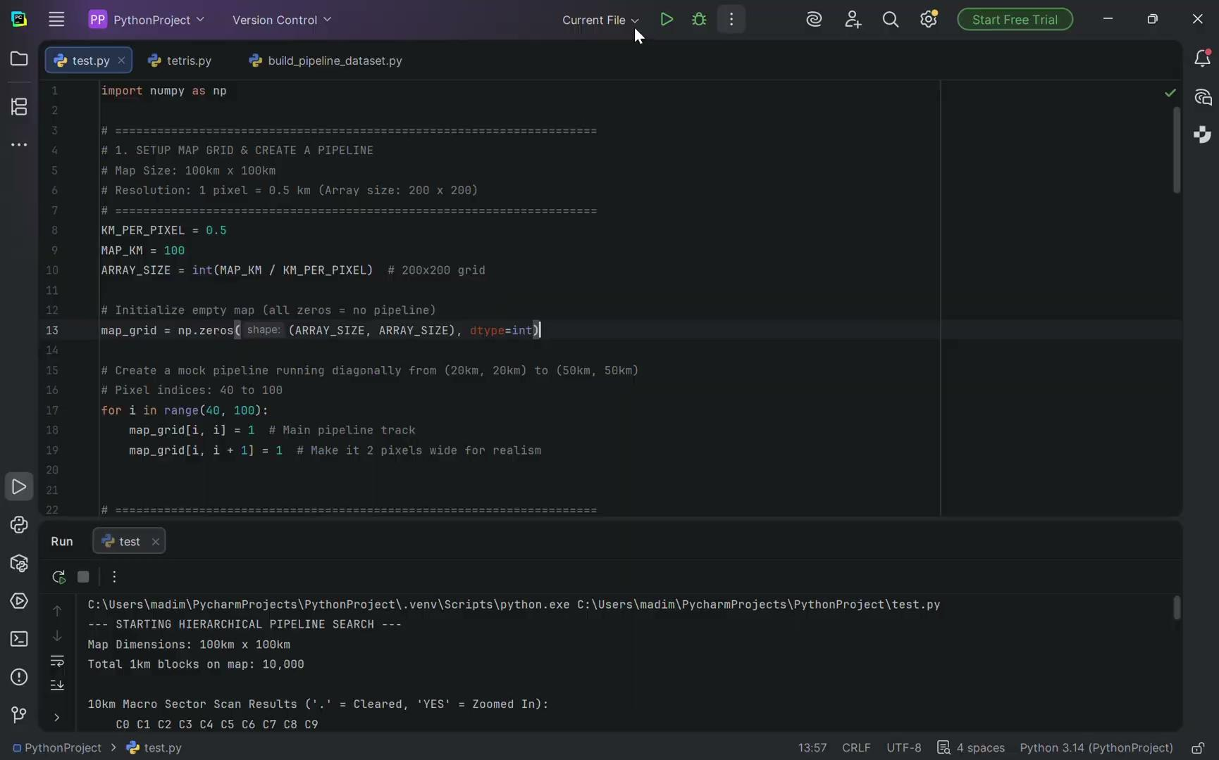

How our prototype works
Pipeline detection
Splitting images
Comparing images
We trained a model to detect oil pipelines in nova scotia by pulling satellite images from google earth
We then split the image and discard any of the smaller images without the pipeline
Finally, these smaller images are compared to the onboard database to spot any obstructions

Slide 7
Major Problems
Finding a Dataset
Linking components together
Imperfect obstruction detection

Slide 8
Future Scalability
A second machine learning component
Connecting the components
Applicability to other fields
Instead of comparing the image we could use a model that detects common obstructions to oil pipelines
Make the program run at once instead of needing human interaction between components
A similar model could also be used to keep track of roads and other similar architectures
Notes:
ML: season changes
Connecting
Applicability: remote roads

Slide 9
Thanks for listening

